Slide 1
Reinforcement Learning

Slide 2
Robot in a room
 |  |  | +1
 |  |  | -1
START
actions: UP, DOWN, LEFT, RIGHT
UP
80% move UP
10% move LEFT
10% move RIGHT
reward +1 at [4,3], -1 at [4,2]
reward -0.04 for each step
what’s the strategy to achieve max reward?
what if the actions were deterministic?
Notes:
want to learn a policy (what’s the solution?)
can we learn it using (un)supervised learning? why not?
so how do we learn it? any ideas?
let the robot explore the environment

Slide 3
Other examples
pole-balancing
TD-Gammon [Gerry Tesauro]
helicopter [Andrew Ng]
no teacher who would say “good” or “bad”
  is reward “10” good or bad?
  rewards could be delayed
similar to control theory
  more general, fewer constraints
explore the environment and learn from experience
  not just blind search, try to be smart about it

Slide 4
Resource allocation in datacenters
A Hybrid Reinforcement Learning Approach to Autonomic Resource Allocation
  Tesauro, Jong, Das, Bennani (IBM)
  ICAC 2006
loadbalancer
application A
application B
application C

Slide 5
Outline
examples
defining an RL problem
  Markov Decision Processes
solving an RL problem
  Dynamic Programming
  Monte Carlo methods
  Temporal-Difference learning

Slide 6
Robot in a room
 |  |  | +1
 |  |  | -1
START
actions: UP, DOWN, LEFT, RIGHT
UP
80% move UP
10% move LEFT
10% move RIGHT
reward +1 at [4,3], -1 at [4,2]
reward -0.04 for each step
states
actions
rewards
what is the solution?
Notes:
want to learn a policy (what’s the solution?)
can we learn it using (un)supervised learning? why not?
so how do we learn it? any ideas?
let the robot explore the environment

Slide 7
Is this a solution?
only if actions deterministic
  not in this case (actions are stochastic)
solution/policy
  mapping from each state to an action
 |  |  | +1
 |  |  | -1

Slide 8
Optimal policy
 |  |  | +1
 |  |  | -1

Slide 9
Reward for each step: -2
 |  |  | +1
 |  |  | -1

Slide 10
Reward for each step: -0.1
 |  |  | +1
 |  |  | -1

Slide 11
Reward for each step: -0.04
 |  |  | +1
 |  |  | -1

Slide 12
Reward for each step: -0.01
 |  |  | +1
 |  |  | -1

Slide 13
Reward for each step: +0.01
 |  |  | +1
 |  |  | -1

Slide 14
Markov Decision Process (MDP)
set of states S, set of actions A, initial state S₀
transition model P(s,a,s’)
  P( [1,1], up, [1,2] ) = 0.8
reward function r(s)
  r( [4,3] ) = +1
goal: maximize cumulative reward in the long run
policy: mapping from S to A
  π(s) or π(s,a) (deterministic vs. stochastic)
reinforcement learning
  transitions and rewards usually not available
  how to change the policy based on experience
  how to explore the environment
environment
reward
new state
action
agent

Slide 15
Computing return from rewards
episodic (vs. continuing) tasks
  “game over” after N steps
  optimal policy depends on N; harder to analyze
additive rewards
  V(s₀, s₁, …) = r(s₀) + r(s₁) + r(s₂) + …
  infinite value for continuing tasks
discounted rewards
  V(s₀, s₁, …) = r(s₀) + γ*r(s₁) + γ²*r(s₂) + …
  value bounded if rewards bounded

Slide 16
Value functions
state value function: V^{π}(s)
  expected return when starting in s and following π
state-action value function: Q^{π}(s,a)
  expected return when starting in s, performing a, and following π
useful for finding the optimal policy
  can estimate from experience
  pick the best action using Q^{π}(s,a)
Bellman equation
s
a
r
s’

Slide 17

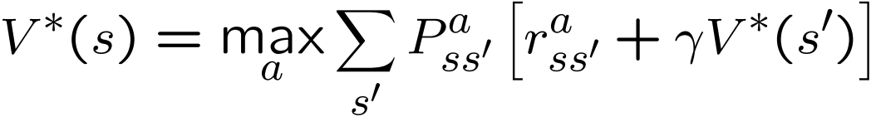

Optimal value functions
there’s a set of optimal policies
  V^{π} defines partial ordering on policies
  they share the same optimal value function
Bellman optimality equation
  system of n non-linear equations
  solve for V*(s)
  easy to extract the optimal policy
having Q*(s,a) makes it even simpler
s
a
r
s’

Slide 18
Outline
examples
defining an RL problem
  Markov Decision Processes
solving an RL problem
  Dynamic Programming
  Monte Carlo methods
  Temporal-Difference learning

Slide 19
Dynamic programming
main idea
  use value functions to structure the search for good policies
  need a perfect model of the environment
two main components
  policy evaluation: compute V^{π} from π
  policy improvement: improve π based on V^{π}
  start with an arbitrary policy
  repeat evaluation/improvement until convergence

Slide 20
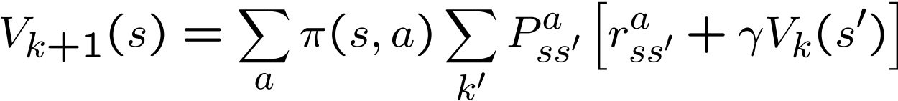

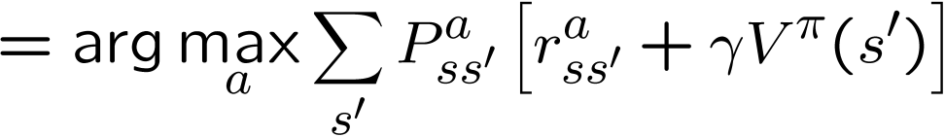
Policy evaluation/improvement
policy evaluation: π -> V^{π}
  Bellman eqn’s define a system of n eqn’s
  could solve, but will use iterative version
  start with an arbitrary value function V₀, iterate until V_{k} converges
policy improvement: V^{π} -> π’
  π’ either strictly better than π, or π’ is optimal (if π = π’)

Slide 21
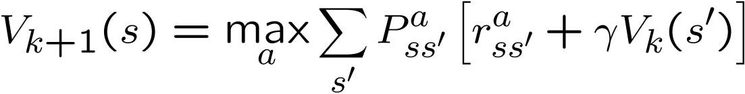
Policy/Value iteration
Policy iteration
  two nested iterations; too slow
  don’t need to converge to V^{πk}
    just move towards it
Value iteration
  use Bellman optimality equation as an update
  converges to V*

Slide 22
Using DP
need complete model of the environment and rewards
  robot in a room
    state space, action space, transition model
can we use DP to solve
  robot in a room?
  back gammon?
  helicopter?

Slide 23
Outline
examples
defining an RL problem
  Markov Decision Processes
solving an RL problem
  Dynamic Programming
  Monte Carlo methods
  Temporal-Difference learning
miscellaneous
  state representation
  function approximation
  rewards

Slide 24
Monte Carlo methods
don’t need full knowledge of environment
  just experience, or
  simulated experience
but similar to DP
  policy evaluation, policy improvement
averaging sample returns
  defined only for episodic tasks

Slide 25
Monte Carlo policy evaluation
want to estimate V^{π}(s)
  = expected return starting from s and following π
  estimate as average of observed returns in state s
first-visit MC
  average returns following the first visit to state s
s
s
s₀
R₁(s) = +2
+1
-2
0
+1
-3
+5
s₀
s₀
R₂(s) = +1
s₀
R₃(s) = -5
s₀
s₀
R₄(s) = +4
V^{π}(s) ≈ (2 + 1 – 5 + 4)/4 = 0.5

Slide 26
Monte Carlo control
V^{π} not enough for policy improvement
  need exact model of environment
estimate Q^{π}(s,a)
MC control
  update after each episode
non-stationary environment
a problem
  greedy policy won’t explore all actions

Slide 27
Maintaining exploration
deterministic/greedy policy won’t explore all actions
  don’t know anything about the environment at the beginning
  need to try all actions to find the optimal one
maintain exploration
  use soft policies instead: π(s,a)>0 (for all s,a)
ε-greedy policy
  with probability 1-ε perform the optimal/greedy action
  with probability ε perform a random action
  will keep exploring the environment
  slowly move it towards greedy policy: ε -> 0

Slide 28
Simulated experience
5-card draw poker
  s₀: A♣, A♦, 6♠, A♥, 2♠
  a₀: discard 6♠, 2♠
  s₁: A♣, A♦, A♥, A♠, 9♠ + dealer takes 4 cards
  return: +1 (probably)
DP
  list all states, actions, compute P(s,a,s’)
    P( [A♣,A♦,6♠,A♥,2♠], [6♠,2♠], [A♠,9♠,4] ) = 0.00192
MC
  all you need are sample episodes
  let MC play against a random policy, or itself, or another algorithm

Slide 29
Summary of Monte Carlo
don’t need model of environment
  averaging of sample returns
  only for episodic tasks
learn from sample episodes or simulated experience
can concentrate on “important” states
  don’t need a full sweep
need to maintain exploration
  use soft policies

Slide 30
Outline
examples
defining an RL problem
  Markov Decision Processes
solving an RL problem
  Dynamic Programming
  Monte Carlo methods
  Temporal-Difference learning
miscellaneous
  state representation
  function approximation
  rewards

Slide 31
Temporal Difference Learning
combines ideas from MC and DP
  like MC: learn directly from experience (don’t need a model)
  like DP: learn from values of successors
  works for continuous tasks, usually faster than MC
constant-alpha MC:
  have to wait until the end of episode to update
simplest TD
  update after every step, based on the successor
target

Slide 32
MC vs. TD
observed the following 8 episodes:
  A – 0, B – 0 B – 1 B – 1 B - 1
  B – 1 B – 1 B – 1 B – 0
MC and TD agree on V(B) = 3/4
MC: V(A) = 0
  converges to values that minimize the error on training data
TD: V(A) = 3/4
  converges to ML estimate
  of the Markov process
r = 1
75%
r = 0
100%
A
B
r = 0
25%

Slide 33
Sarsa
again, need Q(s,a), not just V(s)
control
  start with a random policy
  update Q and π after each step
  again, need ε-soft policies
s_{t}
a_{t}
s_{t+1}
a_{t+1}
s_{t+2}
a_{t+2}
r_{t}
r_{t+1}

Slide 34
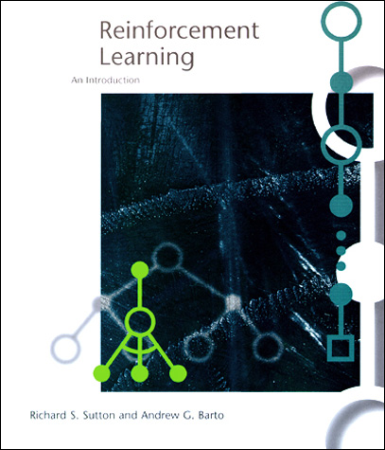
The RL Intro book
Richard Sutton, Andrew Barto
Reinforcement Learning,
An Introduction
http://www.cs.ualberta.ca/
~sutton/book/the-book.html

Slide 35
Q-learning
before: on-policy algorithms
  start with a random policy, iteratively improve
  converge to optimal
Q-learning: off-policy
  use any policy to estimate Q
  Q directly approximates Q* (Bellman optimality eqn)
  independent of the policy being followed
  only requirement: keep updating each (s,a) pair
Sarsa

Slide 36
Outline
examples
defining an RL problem
  Markov Decision Processes
solving an RL problem
  Dynamic Programming
  Monte Carlo methods
  Temporal-Difference learning
miscellaneous
  state representation
  function approximation
  rewards

Slide 37
State representation
pole-balancing
  move car left/right to keep the pole balanced
state representation
  position and velocity of car
  angle and angular velocity of pole
what about Markov property?
  would need more info
  noise in sensors, temperature, bending of pole
solution
  coarse discretization of 4 state variables
    left, center, right
  totally non-Markov, but still works

Slide 38
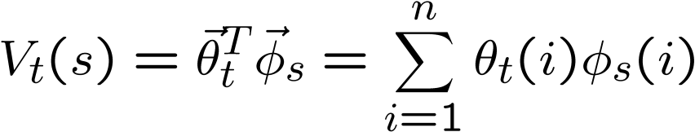
Function approximation
represent V_{t} as a parameterized function
  linear regression, decision tree, neural net, …
  linear regression:
update parameters instead of entries in a table
  better generalization
    fewer parameters and updates affect “similar” states as well
TD update
  treat as one data point for regression
  want method that can learn on-line (update after each step)
x
y

Slide 39
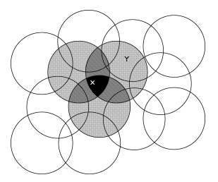
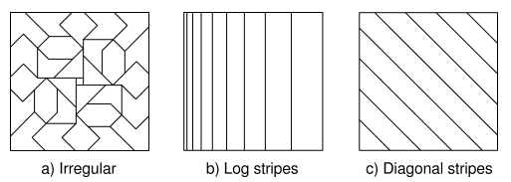
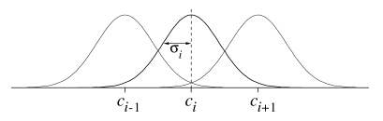
Features
tile coding, coarse coding
  binary features
radial basis functions
  typically a Gaussian
  between 0 and 1
  [ Sutton & Barto, Reinforcement Learning ]

Slide 40
Splitting and aggregation
want to discretize the state space
  learn the best discretization during training
splitting of state space
  start with a single state
  split a state when different parts of that state have different values
state aggregation
  start with many states
  merge states with similar values

Slide 41
Designing rewards
robot in a maze
  episodic task, not discounted, +1 when out, 0 for each step
chess
  GOOD: +1 for winning, -1 losing
  BAD: +0.25 for taking opponent’s pieces
    high reward even when lose
rewards
  rewards indicate what we want to accomplish
  NOT how we want to accomplish it
shaping
  positive reward often very “far away”
  rewards for achieving subgoals (domain knowledge)
  also: adjust initial policy or initial value function
Notes:
maybe show the pendulum?

Slide 42
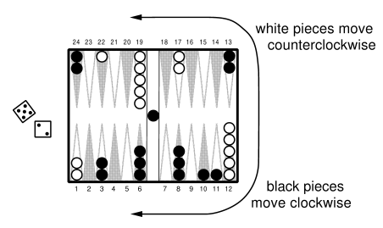
Case study: Back gammon
rules
  30 pieces, 24 locations
  roll 2, 5: move 2, 5
  hitting, blocking
  branching factor: 400
implementation
  use TD(λ) and neural nets
  4 binary features for each position on board (# white pieces)
  no BG expert knowledge
results
  TD-Gammon 0.0: trained against itself (300,000 games)
    as good as best previous BG computer program (also by Tesauro)
    lot of expert input, hand-crafted features
  TD-Gammon 1.0: add special features
  TD-Gammon 2 and 3 (2-ply and 3-ply search)
    1.5M games, beat human champion

Slide 43
Summary
Reinforcement learning
  use when need to make decisions in uncertain environment
solution methods
  dynamic programming
    need complete model
  Monte Carlo
  time-difference learning (Sarsa, Q-learning)
most work
  algorithms simple
  need to design features, state representation, rewards

